Slide 1


NFT 图文数据的跨模态检索
NFT界的Google搜索
汇报人：王树勋
Notes:
各位老师，同学们大家好！ 我是树勋，今天由我给大家带来今天的组会分享

Slide 2
Background
CONSTRUCTING NFT 1000
Experiment & Demo
Future Work

Slide 3
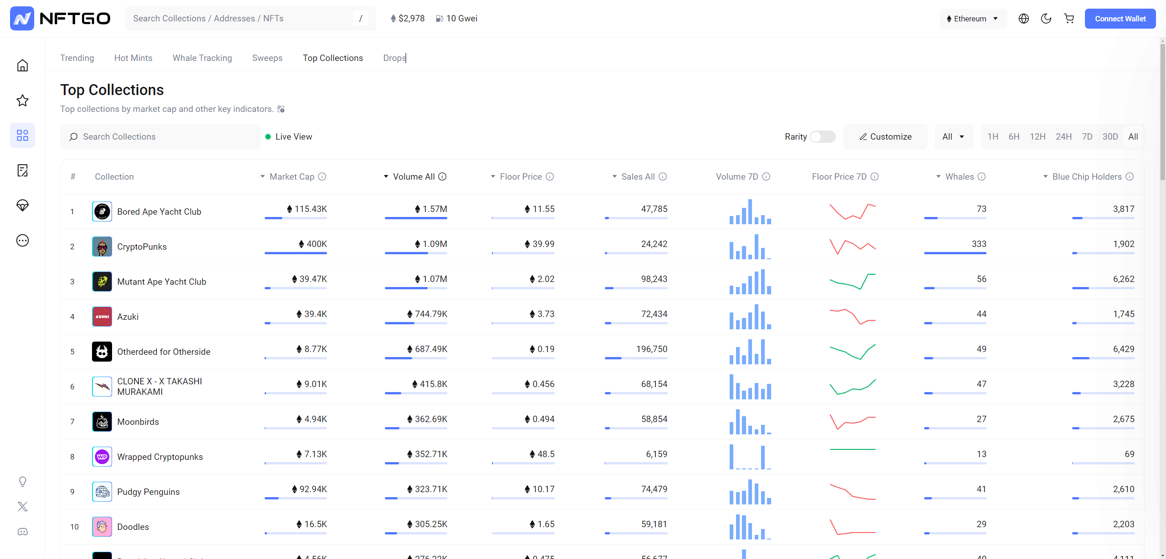
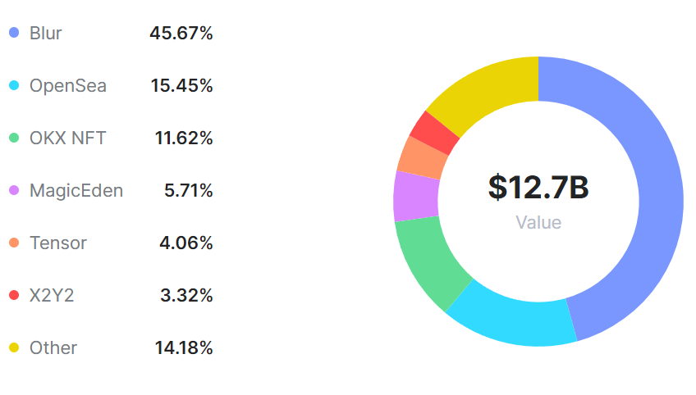
Background
Top Sales
$ 36.777 亿
$ 27.835 亿
$ 25.232 亿
$ 16.150 亿
$ 14.530 亿
$ 9.915 亿
$ 8.396 亿
$ 6.413 亿
$ 7.574 亿
$ 7.336 亿
https://www.nftscan.com/marketplace
https://nftgo.io/discover/top-collections
2024.4.18 16:45 1ETH = $ 2,976.0452

Slide 4


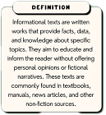
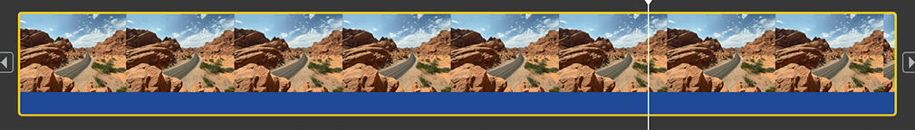

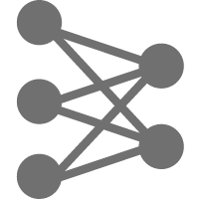



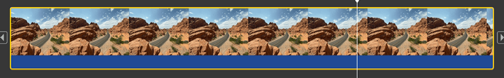

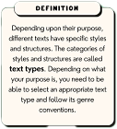

Background
Cross-Modal Retrieval
Cross-modal retrieval aims to use the representation of data in one modality as a query to retrieve related data in another modality. A well-trained AI model encodes semantically similar text, audio, or visual inputs into nearby points in a shared vector space. The target output is then obtained by calculating the "distance" between these feature vectors.
Image
Audio
Text
Video
Slow
Model
Database
VisualBERT
Single-stream
Pixel-BERT
Fusion
Encoder
SimVLM
ViLBERT
Modality
Aggregation
Dual-stream
ALBEF
CLIP
Dual
Encoder
ALIGN
Images
Audios
Texts
Videos
EVA-CLIP
Notes:
跨模态检索旨在利用一种模态的数据表征作为查询，检索与之相关的另一类型的模态数据。经过完备训练的AI模型中的文本/视觉编码器会将语义相似的文本/音视频编码到相近的向量空间，通过计算其与数据库中预设向量空间中备选特征的“距离”得到目标输出。

Slide 5
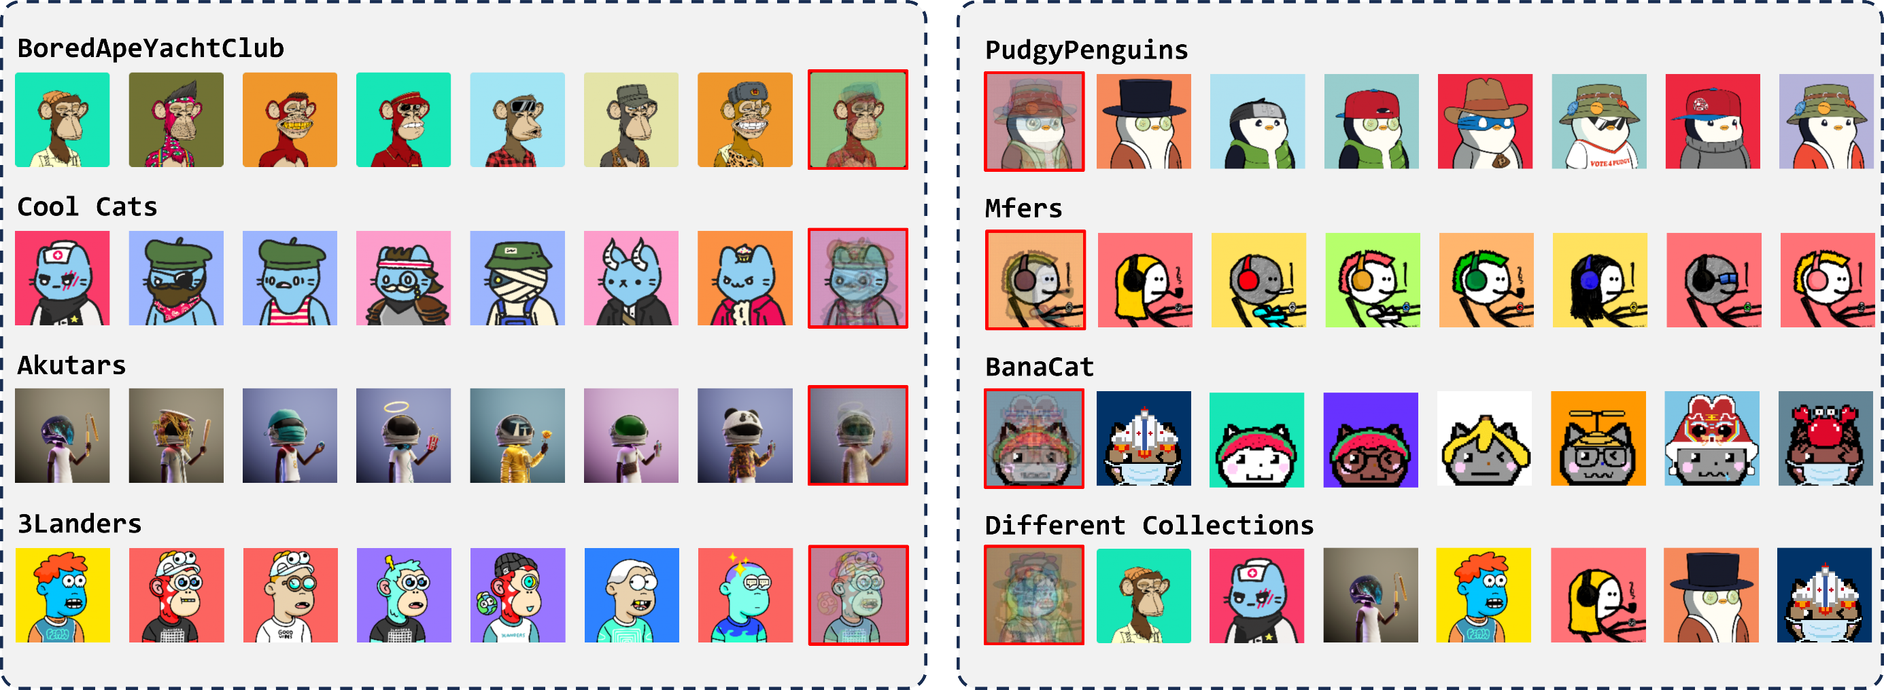
Background
High Similarity
Notes:
具体到NFT数据本身，具有一些独特的特性

Slide 6
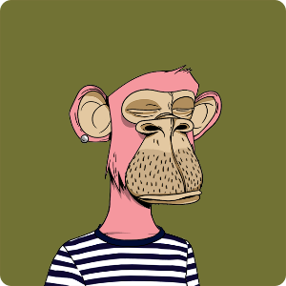


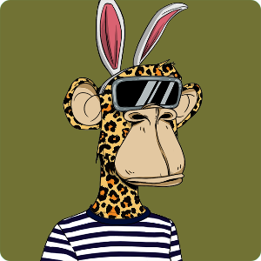
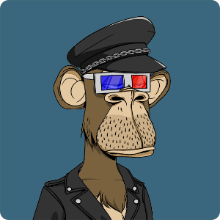
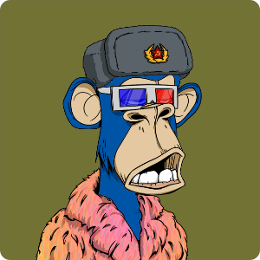
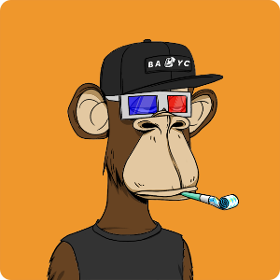
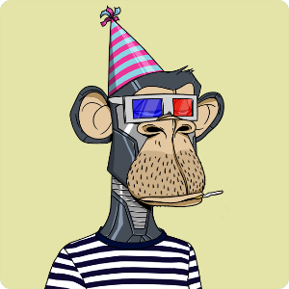
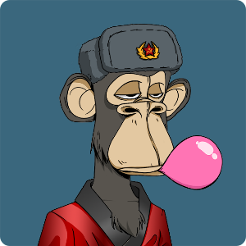
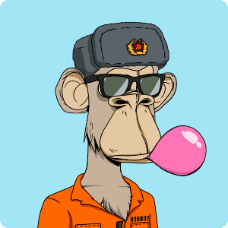

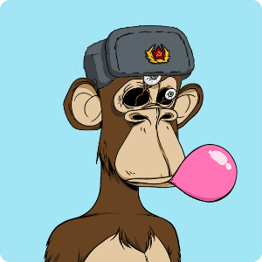
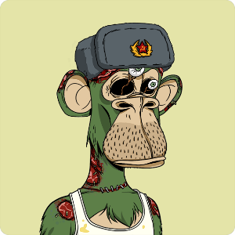
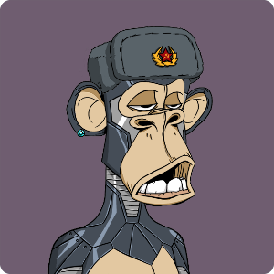
Background
Fixed-layer permutation and combination
Clothes：Navy striped tee
Eyes：3d
(a)
(b)
Mouth：Bored bubblegum
Hat：Commie hat
(c)
(d)

Slide 7
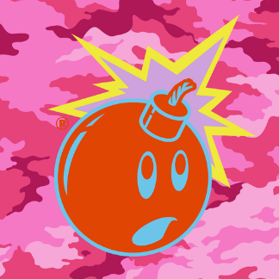
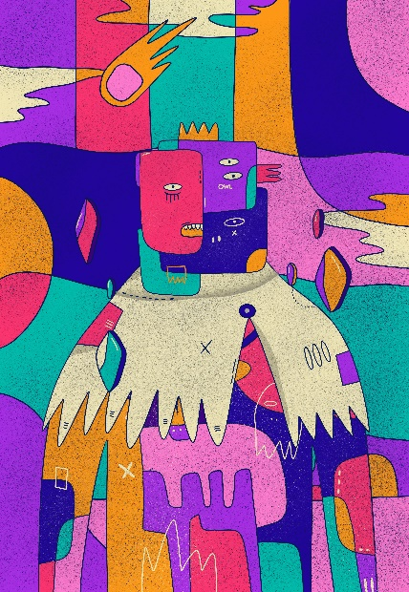
Background
Abstract Description
{
"attributes": [
{"trait_type": "Character", "value": "Color Adam"},
{"trait_type": "Bomb Type", "value": "Classic"},
{"trait_type": "Colorway", "value": "Color Red"},
{"trait_type": "Distribution", "value": "General Release"},
{"trait_type": "Year", "value": "2018"},
{"trait_type": "Spark", "value": "Yes"},
{"trait_type": "Branded", "value": "No"},
{"trait_type": "Background Name", "value": "Camo"},
{"trait_type": "Background Colorway", "value": "Perfect Camo Pink"},
{"trait_type": "Background Year", "value": "2014"},
{"trait_type": "Background Branded", "value": "No"},
{"trait_type": "Error Terror", "value": "No"},
{"trait_type": "Double Trouble", "value": "No"},
{"trait_type": "Broken Background", "value": "No"}
]
}
{
"attributes": [
{"trait_type": "角色", "value": "色彩亚当"},
{"trait_type": "炸弹类型", "value": "经典"},
{"trait_type": "颜色方案", "value": "红色"},
{"trait_type": "分布", "value": "通用发行"},
{"trait_type": "年份", "value": "2018"},
{"trait_type": "火花", "value": "是"},
{"trait_type": "品牌化", "value": "否"},
{"trait_type": "背景名称", "value": "迷彩"},
{"trait_type": "背景颜色方案", "value": "完美迷彩粉"},
{"trait_type": "背景年份", "value": "2014"},
{"trait_type": "背景品牌化", "value": "否"},
{"trait_type": "错误恐怖", "value": "否"},
{"trait_type": "双重麻烦", "value": "否"},
{"trait_type": "破损背景", "value": "否"}
]
}
Adam Bomb Squad
# 1
Superlative Secret Society
{
"attributes": [
{"trait_type": "Background", "value": "Chummy"},
{"trait_type": "Body", "value": "Captivating"},
{"trait_type": "Necklace", "value": "Obedient"},
{"trait_type": "Muffler", "value": "Folksy"},
{"trait_type": "Head", "value": "Lyrical"},
{"trait_type": "Orbs", "value": "Contemptible"},
{"trait_type": "Foreground", "value": "Restrained"},
{"trait_type": "Galaxy Glitter", "value": "Unfoolable"}
]
}
{
"attributes": [
{"trait_type": "背景", "value": "友好"},
{"trait_type": "身体", "value": "迷人"},
{"trait_type": "项链", "value": "顺从"},
{"trait_type": "围巾", "value": "朴实"},
{"trait_type": "头部", "value": "抒情"},
{"trait_type": "眼球", "value": "可鄙"},
{"trait_type": "前景", "value": "克制"},
{"trait_type": "星河闪烁", "value": "难以愚弄"}
]
}
# 6
Notes:
NFT在一定程度上可以说是数字艺术品，既然是艺术品，那么他的作者在创作他们的时候就会有很大的主观因素在里面，有时候作者对NFTtoken的描述是极其抽象的，也就是不知所云。

Slide 8
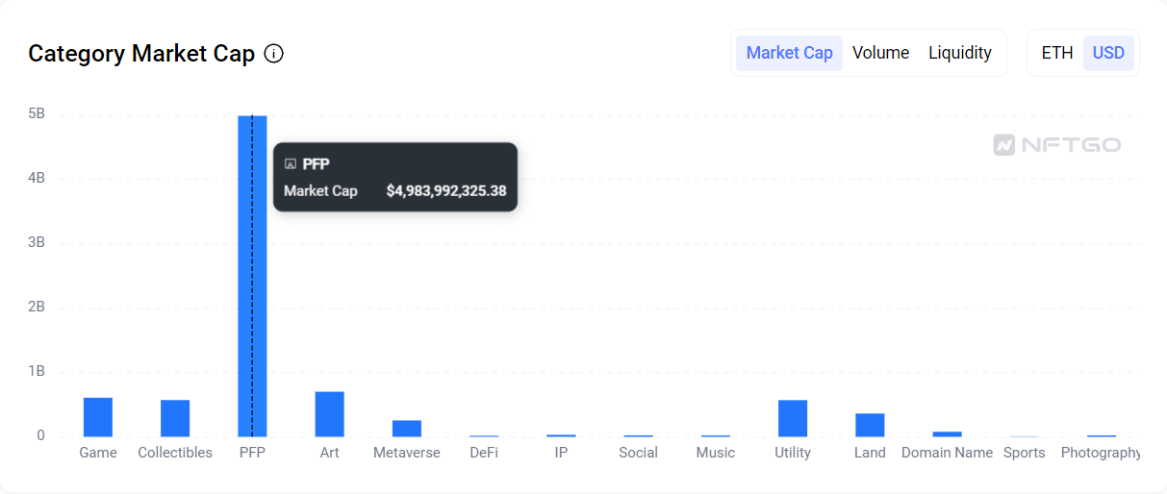

CONSTRUCTING NFT1000
{
"attributes": [
{
"value": "95",
"trait_type": "Background"
},
{
"value": "Albino",
"trait_type": "Body"
},
{
"value": "Fun Cap",
"trait_type": "Head"
},
{
"value": "Long Cigarette",
"trait_type": "Accessory II"
},
{
"value": 4,
"trait_type": "# Traits"
}
]
}
Clarifying the Targets
Ethereum Top1000 PFP ERC-721 NFT collections
https://nftgo.io/analytics/market-overview
Notes:
目前计算机视觉业界内尚且没有NFT元数据构成的数据集可供使用，所以我们就自己构造了一个数据集，名字叫 “NFT Top1000 Visual-Text Dataset“ 简称NFT1000
PFP 类项目占据超60% 的市场份额，选择它也是因为它是主流
Select 2493 projects from 5618

Slide 9





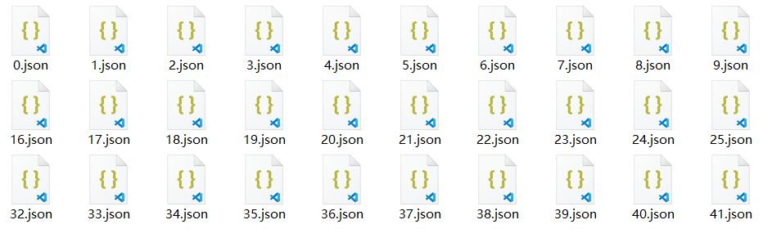
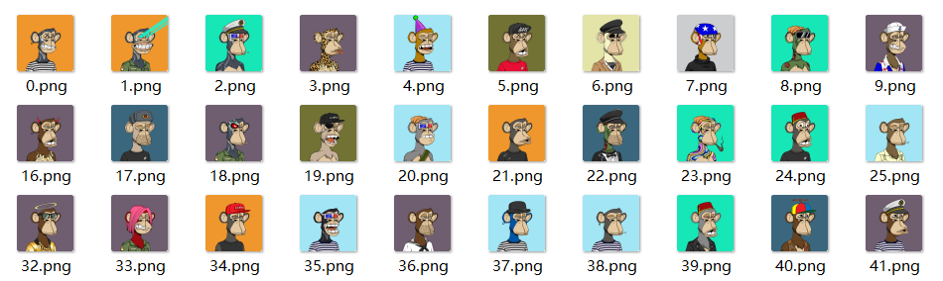
CONSTRUCTING NFT1000
Download
Base_URI + source_index
Smart Contract Address : 0xBC4CA0EdA7647A8aB7C2061c2E118A18a936f13D
baseURI : ipfs://QmeSjSinHpPnmXmspMjwiXyN6zS4E9zccariGR3jxcaWtq/
Metadata_Source : ipfs://QmeSjSinHpPnmXmspMjwiXyN6zS4E9zccariGR3jxcaWtq/0
"image": "ipfs://QmRRPWG96cmgTn2qSzjwr2qvfNEuhunv6FNeMFGa9bx6mQ"
Multi-Platform, Multi-Process, Multi-Threaded Rapid Download of All Resources in the Target Collection
1250 collections 14TB
Notes:
并没有现成的数据包放在那里等的去下载 资源需要去拼凑出来
5-6种下载方式 混着用

Slide 10
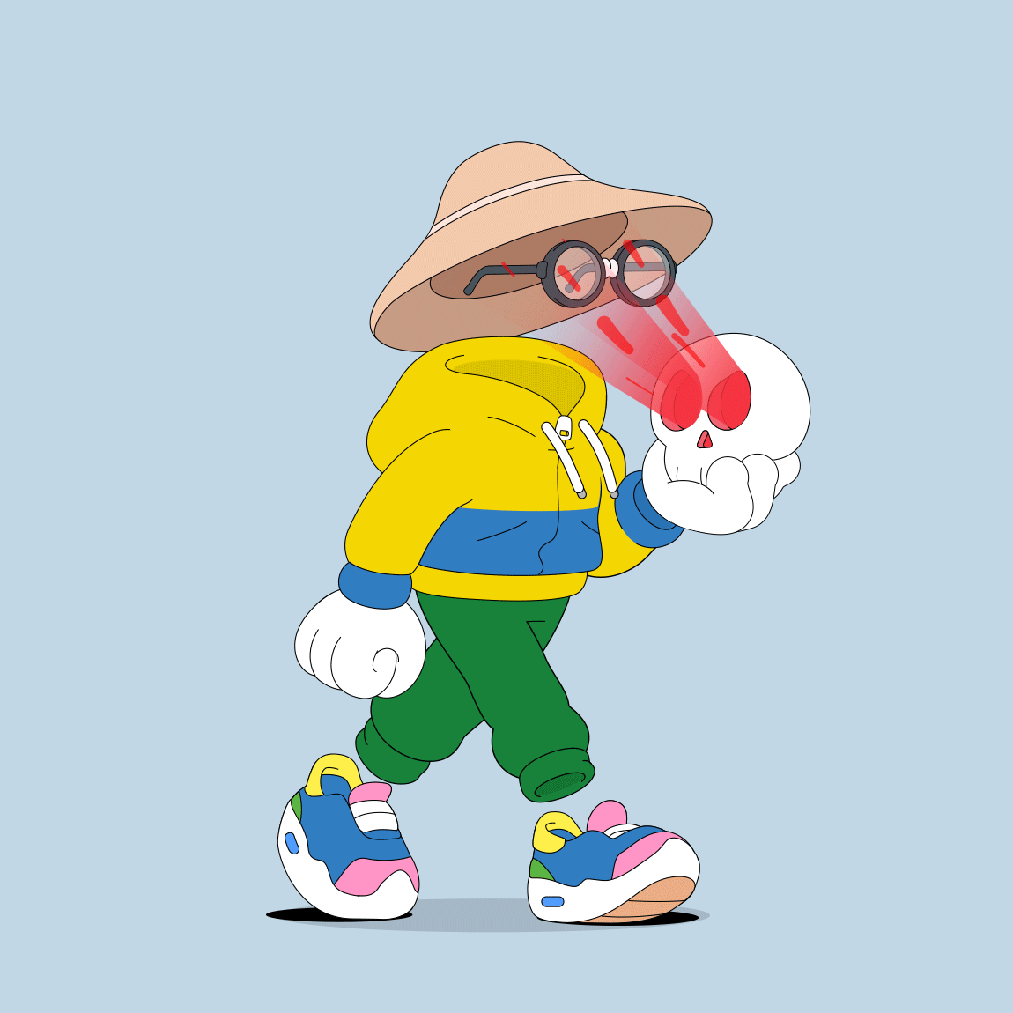
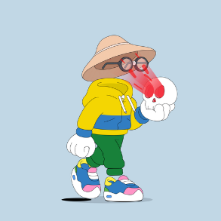




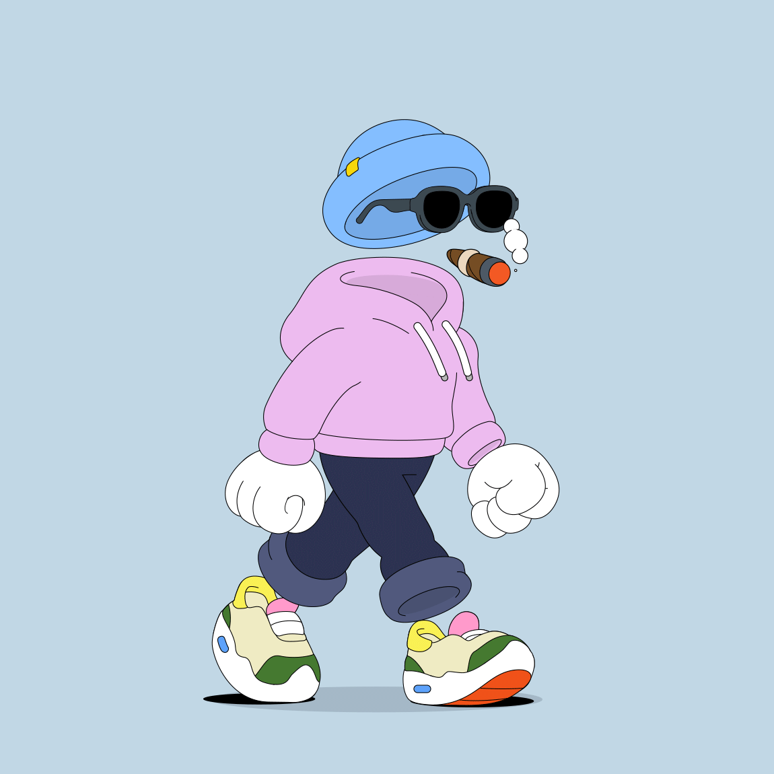
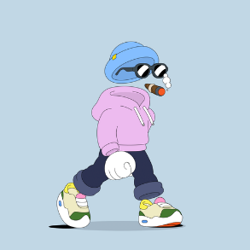




Construct NFT1000
Filter & standardize
Collection with completely duplicated media data
Projects with less than 500 NFT tokens
Projects lack JSON files or where the JSON files contain no substantive semantic information.
JPG, JPEG, SVG, PNG, WebP, GIF, MP4
PNG
Width : 512 pixels
Height : adaptive
14TB → 1.75TB

Slide 11
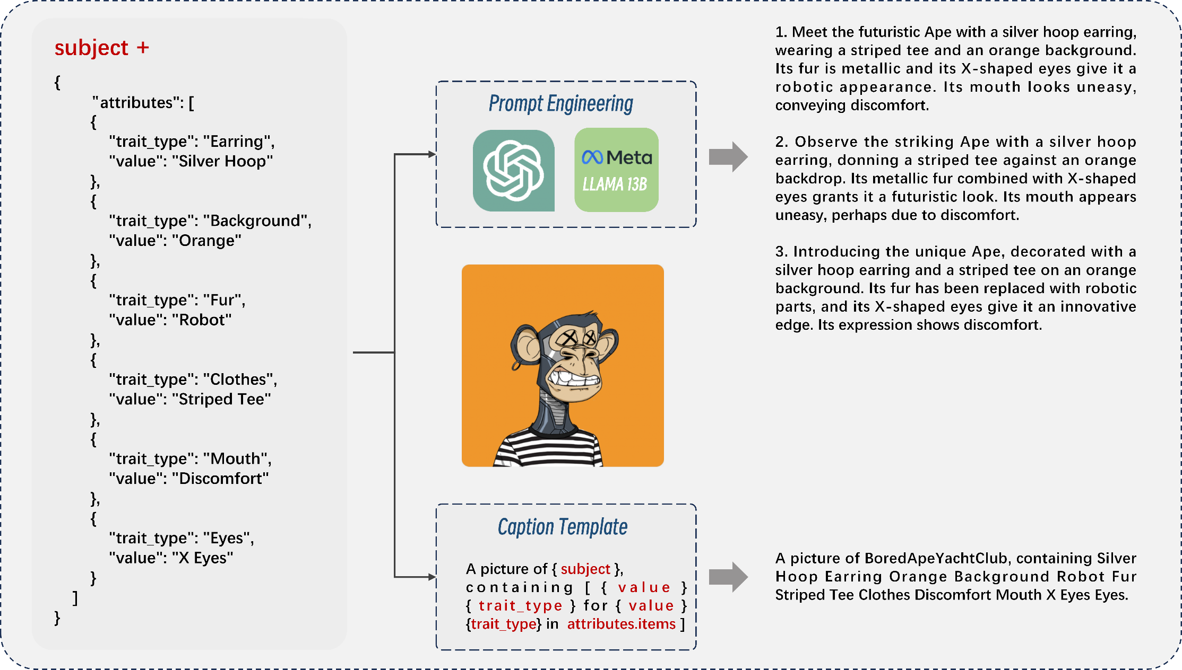
CONSTRUCTING NFT1000
Caption Extraction

Slide 12
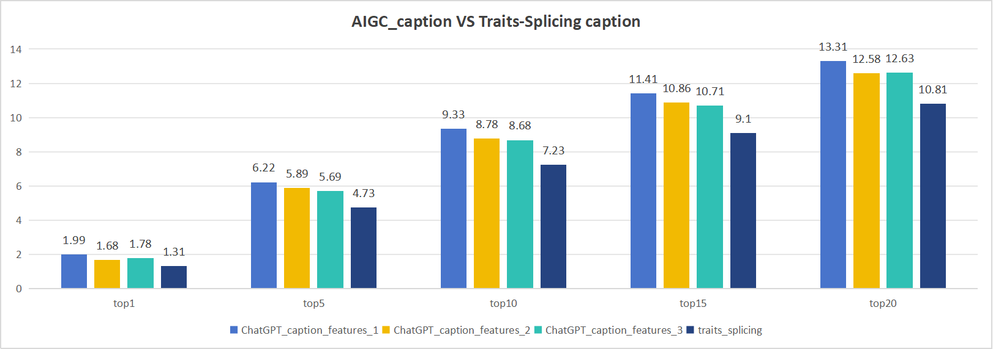
CONSTRUCTING NFT1000
Caption Extraction
Notes:
CLIP-ViT-L 14 预训练模型进行zeroshot推理

Slide 13
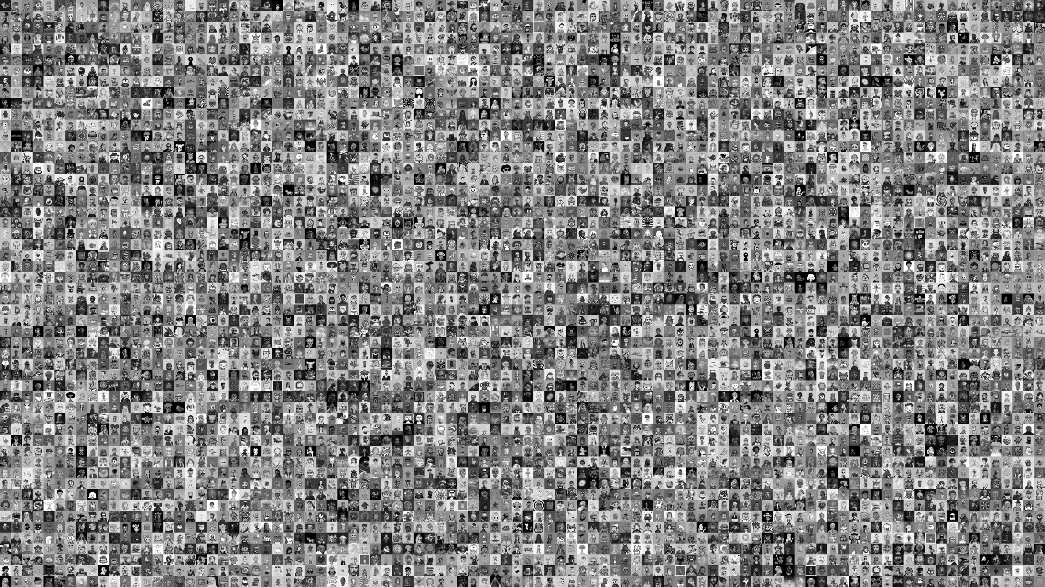
NFT 1000
Connect AI & Blockchain
Img-Cap pairs: 756.3W DataSize：1.75TB
Theme: 356 Phrase：60W
Type : 3D rendered images, 2D flat illustrations, pixel arts, NPC characters, real photograph, etc

Slide 14
CONSTRUCTING NFT1000
Data Partition
NFT 100 mini
NFT 1000 mini
NFT 1000
Training Set:
Training Set:
Training Set:
Pro_num: 80
Img-Cap pairs: 40000
Pro_num: 800
Img-Cap pairs: 794698
Pro_num: 800
Img-Cap pairs: 6178249
Validation set:
Validation set:
Validation set:
Pro_num: 5
Img-Cap pairs: 2500
Pro_num: 50
Img-Cap pairs: 49738
Pro_num: 50
Img-Cap pairs: 383916
Test Set:
Test Set:
Test Set:
Pro_num: 15
Img-Cap pairs: 7500
Pro_num: 150
Img-Cap pairs: 147615
Pro_num: 150
Img-Cap pairs: 1000838
Notes:
以NFT项目维基础单位进行划分，解释一下原因：
80：5 ： 15

Slide 15
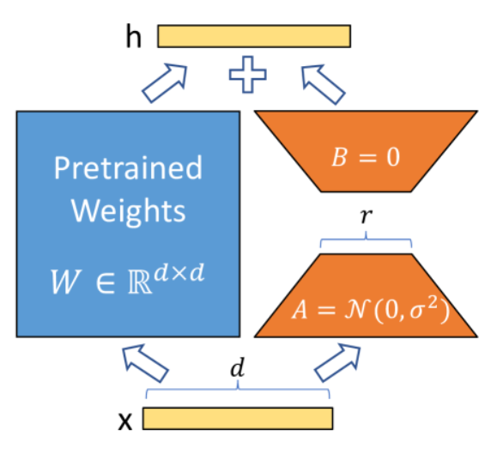


Experiments
Generation
1. Train LORA
Train the LORA plugin based on the SD model for a specific project
2. Generate Metadata
Determine which attributes make up the target NFT, enumerate a series of values for each attribute, and first construct a JSON file through permutations and combinations at the attribute level.
3. Base Model + LORA + Prompts
Synthesize the use of the basic diffusion model, LORA, and related prompts to generate a series of high-quality, coherent images

Slide 16















Azuki_SD
1.5
（a）
Prompt: 1boy,Blonde Swept Back Hair,Red Stripes Face Paint Face,Red Perfecto Jacket Clothing,Suspicious Eyes,Chuckle Mouth,Leather Katana Offhand,Red Background,<lora:azuki:1>
（b）
Prompt：1gir,lViolet Flowy Hair,Sloth Kimono Clothing,Calm Eyes,Smile Mouth,Guitar,Offhand Dark Blue Background,<lora: azuki:1>,
(masterpiece:1.2),best quality,masterpiece,highres,original,extremely detailed wallpaper,perfect lighting,(extremely detailedCG:1.2),drawing,paintbrush,
（c）
Prompt：1girl,Water Hair,(space_suit_1.2),Striking Eyes,Frown Mouth,holding gun,3Dglasses,glass space helmet, space_background, <lora:azuki:1>

Slide 17
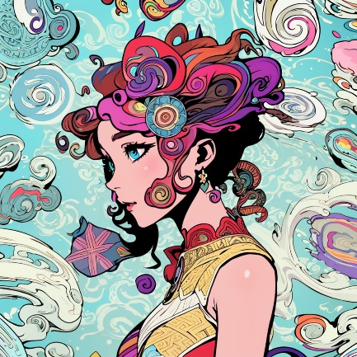

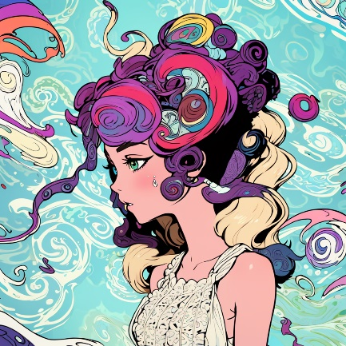












Azuki_toonyou

Slide 18










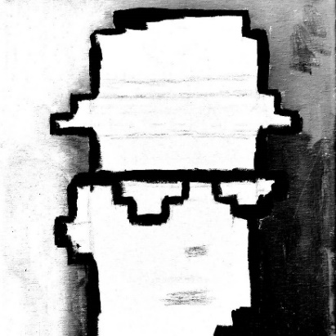




CRYPTOPUNKS

Slide 19


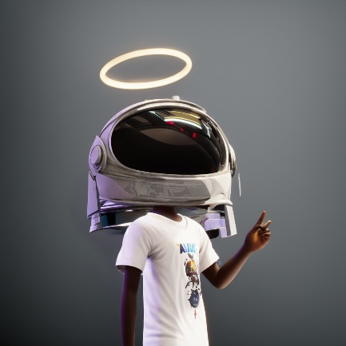


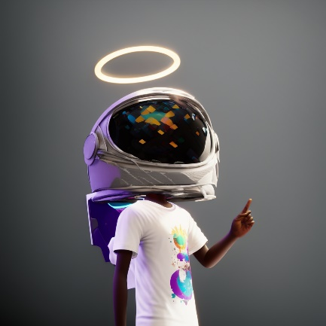

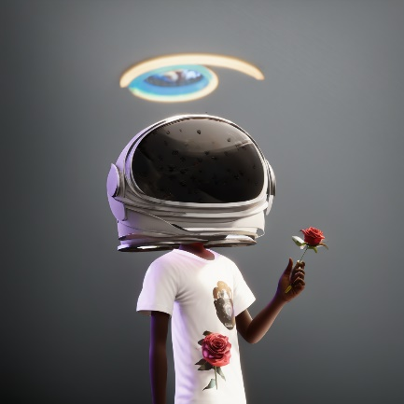

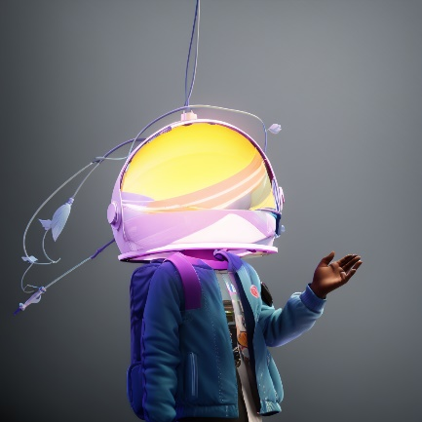




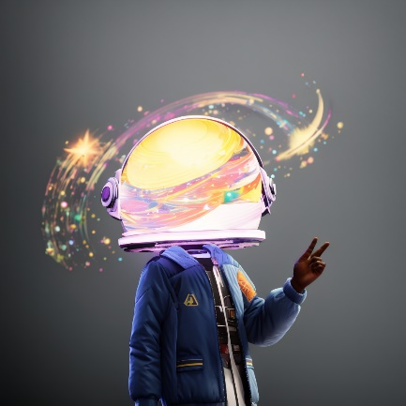
Akutars

Slide 20
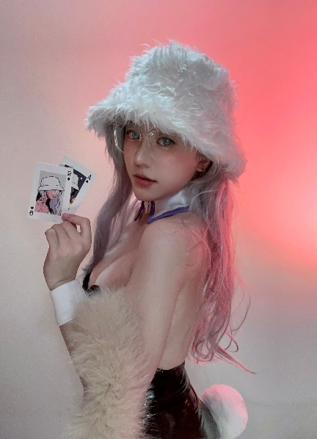

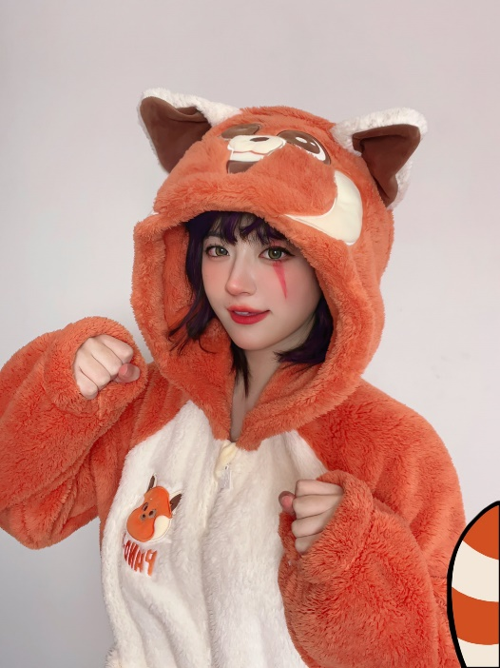



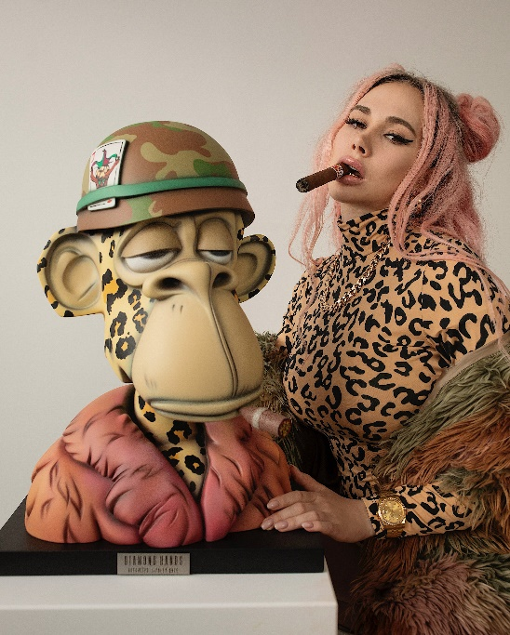
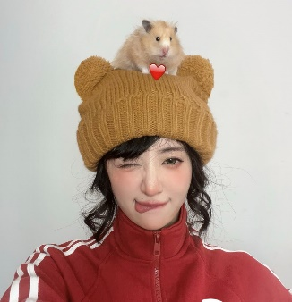



Future Work
Recommendation
Kirara
@0xKirara

Slide 21







Blockchain is Not a Lawless Land: NFT Copyright Authentication
《 NFT Fraud Detection Company Yakoa Secures $4.8 Million in Seed Funding》
Scott Gray, Founder of Genie and Head of NFT Products at Uniswap Labs, believes that “in a decade, most of the world’s intellectual property will be stored on blockchains. Their mediums will range from virtual worlds, to marketplaces, social, and publishers. Yakoa is protecting creators and their communities from fraudulent infringements. We’re going to see the world’s largest brands and NFT collections leveraging Yakoa to protect their IP across all experiences.”
Azuki # 3280
Ethereum
16.00
0xZuki # 12998
Ethereum
--.--
website：https://www.yakoa.io/
Report link：https://medium.com/@yakoa/yakoa-raises-4-8m-to-combat-intellectual-property-fraud-in-web3-973efcc8087d
DEZUKI # 2749
Bzuki # 67
Kidzuki # 4739
Ethereum
0.010
Ethereum
--.--
Ethereum
0.06

Slide 22
Future Work
Depth Vertical
Expanding the NFT Dataset: We aim to broaden our scope by continuing to collect outstanding projects from public blockchains such as Solana, Klaytn, and others, with a target of reaching 100 million image-text pairs.
Training Multimodal Large Language Models: We will train large-scale multimodal language models, integrating Retrieval-Augmented Generation (RAG) techniques to offer personalized NFT recommendations through intelligent Q&A interactions.
Developing a Full-Chain NFT Search Engine: Our goal is to create a comprehensive search engine tailored specifically for the NFT domain. This engine will search off-chain data and then return to the blockchain for final tracking, ensuring a seamless and efficient user experience.
Image-Based Search and Copyright Infringement Detection: We will implement image-based search capabilities and develop tools for detecting NFT piracy, providing robust solutions to safeguard intellectual property.
NFT Generation: We plan to train generative models specifically designed for NFT data, facilitating the creation of new NFTs and enhancing creative possibilities within the ecosystem.
Integrating the Full-Service Chain for NFTs: Production, Sales, Retrieval, Recommendation, and Copyright Authentication

Slide 23



Accept！
ACM Multimedia 2024
《 NFT1000: A Cross-Modal Dataset For Non-Fungible Token Retrieval 》
Openreview：https://openreview.net/forum?id=xUtNrKH8iB
Notes:
https://openreview.net/forum?id=xUtNrKH8iB

Slide 24
谢谢大家！

